Slide 1
Machine learning w H2O (2): Ensemble methods
22-11-2017, Michał

Slide 2
Plan prezentacji
1. Drzewa klasyfikacyjne i regresyjne – CART
2. Czym są Ensemblery ?
3. Bootstrap agregation (Bagging)
4. Boosting
5. Stacking
Notes:
A transparent future is technically a sequential future with instant signaling of conditions (including errors and warnings) and where evaluation, and therefore also assignments, take place in the calling environment. Transparent futures are particularly useful for troubleshooting errors that are otherwise hard to narrow down.
A multisession future is evaluated in a background R session running on the same machine as the calling R process. (wiele procesów R)
Multicore: forking of processes. Forking an R process is considered faster than working with a separate R session running in the background. One reason is that the overhead of exporting large globals to the background session can be greater than when forking is used. The only real different between using multicore and multisession futures is that any output written (to standard output or standard error) by a multicore process is instantaneously outputted in calling process
Multiprocess: nie wiemy więc chcemy oba. Sometimes we do not know whether multicore futures are supported or not, but it might still be that we would like to write platform-independent scripts or instructions that work everywhere.
cl <- parallel::makeCluster(c("n1", "n2", "n3"))
plan(cluster, workers=cl)
Remote: remote R sessions

Slide 3
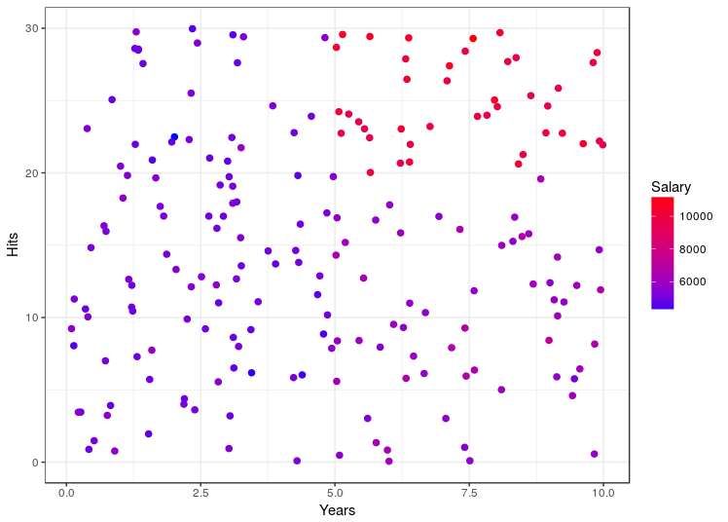
Problem
Za pomocą zmiennych Hits oraz Years przewidzieć zarobki (Salary) zawodnika.
Notes:
A transparent future is technically a sequential future with instant signaling of conditions (including errors and warnings) and where evaluation, and therefore also assignments, take place in the calling environment. Transparent futures are particularly useful for troubleshooting errors that are otherwise hard to narrow down.
A multisession future is evaluated in a background R session running on the same machine as the calling R process. (wiele procesów R)
Multicore: forking of processes. Forking an R process is considered faster than working with a separate R session running in the background. One reason is that the overhead of exporting large globals to the background session can be greater than when forking is used. The only real different between using multicore and multisession futures is that any output written (to standard output or standard error) by a multicore process is instantaneously outputted in calling process
Multiprocess: nie wiemy więc chcemy oba. Sometimes we do not know whether multicore futures are supported or not, but it might still be that we would like to write platform-independent scripts or instructions that work everywhere.
cl <- parallel::makeCluster(c("n1", "n2", "n3"))
plan(cluster, workers=cl)
Remote: remote R sessions

Slide 4
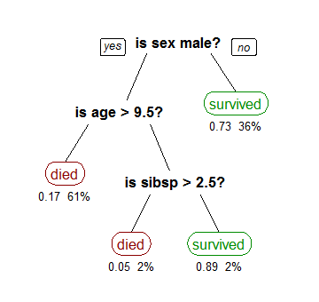
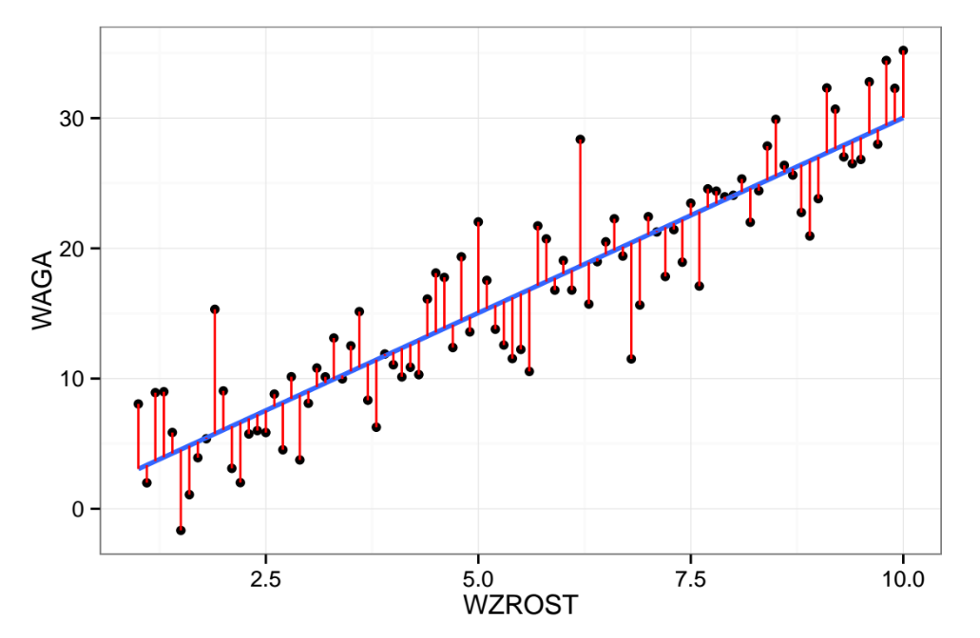
Jakie rozwiązanie zastosować
Klasyczne rozwiązanie przy pomocy regresji liniowej.
W tym przypadku lepiej użyć CART
min_{β} (y - Xβ)²
min_{i} Σ_{i}(y - c_{i})
Dopasowanie modelem CART
Dopasowanie regresją liniową
library(tree)
cart_model <- tree(Salary ~ Years + Hits,
data = dane)
lg_model <- lm(Salary ~ Years + Hits,
data = dane)
Notes:
A transparent future is technically a sequential future with instant signaling of conditions (including errors and warnings) and where evaluation, and therefore also assignments, take place in the calling environment. Transparent futures are particularly useful for troubleshooting errors that are otherwise hard to narrow down.
A multisession future is evaluated in a background R session running on the same machine as the calling R process. (wiele procesów R)
Multicore: forking of processes. Forking an R process is considered faster than working with a separate R session running in the background. One reason is that the overhead of exporting large globals to the background session can be greater than when forking is used. The only real different between using multicore and multisession futures is that any output written (to standard output or standard error) by a multicore process is instantaneously outputted in calling process
Multiprocess: nie wiemy więc chcemy oba. Sometimes we do not know whether multicore futures are supported or not, but it might still be that we would like to write platform-independent scripts or instructions that work everywhere.
cl <- parallel::makeCluster(c("n1", "n2", "n3"))
plan(cluster, workers=cl)
Remote: remote R sessions

Slide 5
Czym jest i jak działa CART
CART jest jednym z algorytmów (inne to np. C4.5, C5.0, ID3) budowy drzew decyzyjnych w celu klasyfikacji lub regresji. Celem budowy drzewa jest podział przestrzeni na prostokątne obszary tak, aby zminimalizować pewien z góry ustalony błąd (funkcję straty) np. błąd średnio-kwadratowy (MSE). Obszary te nazywamy liśćmi, a punkty w których dokonujemy podziału wierzchołkami drzewa. Predykcja w każdym liściu to zwykła średnia wartości zmiennej objaśnianej w przypadku regresji lub modalna w przypadku klasyfikacji.
Algorytm dokonuje jednego podziału w każdym kroku i robi to zachłannie.
Predykcja jest szybka i łatwa w interpretacji, jednakże wynik jest obciążony dużą wariancją (mała zmiana w danych / outlier może znacząco wpłynąć na wynik), dlatego też CART stosowany jest często w Ensemblerach.
Notes:
A transparent future is technically a sequential future with instant signaling of conditions (including errors and warnings) and where evaluation, and therefore also assignments, take place in the calling environment. Transparent futures are particularly useful for troubleshooting errors that are otherwise hard to narrow down.
A multisession future is evaluated in a background R session running on the same machine as the calling R process. (wiele procesów R)
Multicore: forking of processes. Forking an R process is considered faster than working with a separate R session running in the background. One reason is that the overhead of exporting large globals to the background session can be greater than when forking is used. The only real different between using multicore and multisession futures is that any output written (to standard output or standard error) by a multicore process is instantaneously outputted in calling process
Multiprocess: nie wiemy więc chcemy oba. Sometimes we do not know whether multicore futures are supported or not, but it might still be that we would like to write platform-independent scripts or instructions that work everywhere.
cl <- parallel::makeCluster(c("n1", "n2", "n3"))
plan(cluster, workers=cl)
Remote: remote R sessions

Slide 6
Czym jest i jak działa CART
Szukanie optymalnego podziału
Notes:
A transparent future is technically a sequential future with instant signaling of conditions (including errors and warnings) and where evaluation, and therefore also assignments, take place in the calling environment. Transparent futures are particularly useful for troubleshooting errors that are otherwise hard to narrow down.
A multisession future is evaluated in a background R session running on the same machine as the calling R process. (wiele procesów R)
Multicore: forking of processes. Forking an R process is considered faster than working with a separate R session running in the background. One reason is that the overhead of exporting large globals to the background session can be greater than when forking is used. The only real different between using multicore and multisession futures is that any output written (to standard output or standard error) by a multicore process is instantaneously outputted in calling process
Multiprocess: nie wiemy więc chcemy oba. Sometimes we do not know whether multicore futures are supported or not, but it might still be that we would like to write platform-independent scripts or instructions that work everywhere.
cl <- parallel::makeCluster(c("n1", "n2", "n3"))
plan(cluster, workers=cl)
Remote: remote R sessions

Slide 7
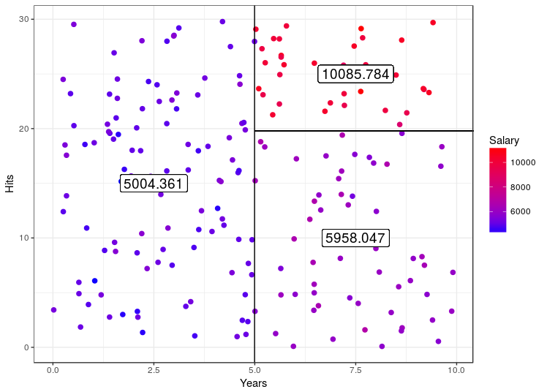
Czym jest i jak działa CART
Notes:
A transparent future is technically a sequential future with instant signaling of conditions (including errors and warnings) and where evaluation, and therefore also assignments, take place in the calling environment. Transparent futures are particularly useful for troubleshooting errors that are otherwise hard to narrow down.
A multisession future is evaluated in a background R session running on the same machine as the calling R process. (wiele procesów R)
Multicore: forking of processes. Forking an R process is considered faster than working with a separate R session running in the background. One reason is that the overhead of exporting large globals to the background session can be greater than when forking is used. The only real different between using multicore and multisession futures is that any output written (to standard output or standard error) by a multicore process is instantaneously outputted in calling process
Multiprocess: nie wiemy więc chcemy oba. Sometimes we do not know whether multicore futures are supported or not, but it might still be that we would like to write platform-independent scripts or instructions that work everywhere.
cl <- parallel::makeCluster(c("n1", "n2", "n3"))
plan(cluster, workers=cl)
Remote: remote R sessions

Slide 8
Czym są Ensemblery ?
Ensemblery to metody, które pozwalają na stworzenie silnego algorytmu machine learningowego z grupy słabych algorytmów (czyli takich, które nie dają nam dobrej odpowiedzi, ale są lepsze od „rzutu kostką”).
Podział:
1. Metody niehybrydowe – korzystają z jednego rodzaju algorytmu:
a) Bootstrap agregation (bagging)
- Random Forest jako specjalny przypadek
b) Boosting
- Gradient Boosting
- AdaBoost
- BrownBoost
- CoBoosting
- …
2. Metody hybrydowe – korzystają z kilku rodzajów algorytmów
a) Stacking (stacked generalization)
b) Cascading
c) Mixture of Experts
Notes:
A transparent future is technically a sequential future with instant signaling of conditions (including errors and warnings) and where evaluation, and therefore also assignments, take place in the calling environment. Transparent futures are particularly useful for troubleshooting errors that are otherwise hard to narrow down.
A multisession future is evaluated in a background R session running on the same machine as the calling R process. (wiele procesów R)
Multicore: forking of processes. Forking an R process is considered faster than working with a separate R session running in the background. One reason is that the overhead of exporting large globals to the background session can be greater than when forking is used. The only real different between using multicore and multisession futures is that any output written (to standard output or standard error) by a multicore process is instantaneously outputted in calling process
Multiprocess: nie wiemy więc chcemy oba. Sometimes we do not know whether multicore futures are supported or not, but it might still be that we would like to write platform-independent scripts or instructions that work everywhere.
cl <- parallel::makeCluster(c("n1", "n2", "n3"))
plan(cluster, workers=cl)
Remote: remote R sessions

Slide 9
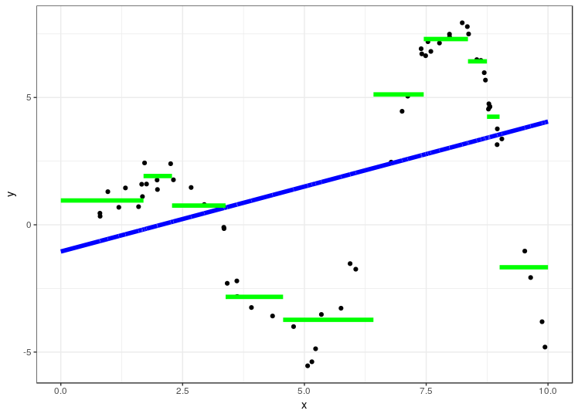
Weak learners
Notes:
A transparent future is technically a sequential future with instant signaling of conditions (including errors and warnings) and where evaluation, and therefore also assignments, take place in the calling environment. Transparent futures are particularly useful for troubleshooting errors that are otherwise hard to narrow down.
A multisession future is evaluated in a background R session running on the same machine as the calling R process. (wiele procesów R)
Multicore: forking of processes. Forking an R process is considered faster than working with a separate R session running in the background. One reason is that the overhead of exporting large globals to the background session can be greater than when forking is used. The only real different between using multicore and multisession futures is that any output written (to standard output or standard error) by a multicore process is instantaneously outputted in calling process
Multiprocess: nie wiemy więc chcemy oba. Sometimes we do not know whether multicore futures are supported or not, but it might still be that we would like to write platform-independent scripts or instructions that work everywhere.
cl <- parallel::makeCluster(c("n1", "n2", "n3"))
plan(cluster, workers=cl)
Remote: remote R sessions

Slide 10
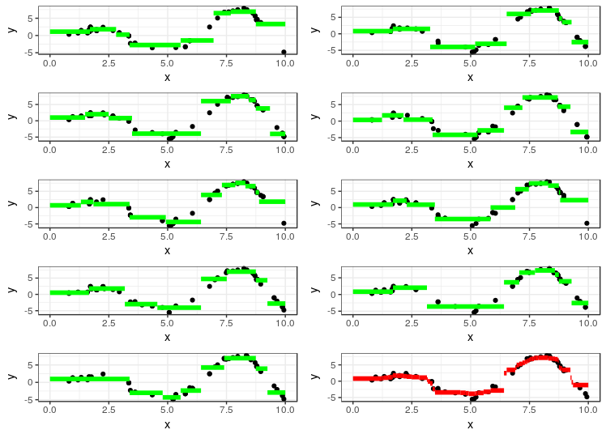
Bagging
Bagging to metoda, w której kolejne modele liczone są równolegle na próbkach bootstrapowych.
Końcowy wynik jest uśrednieniem (lub modalną) wszystkich modeli.
Próby bootstrapowe zbioru (1,2,3,4,5) to np.
(1,1,2,3,2), (1,2,3,5,5),
(5,4,3,4,3), ...
Notes:
A transparent future is technically a sequential future with instant signaling of conditions (including errors and warnings) and where evaluation, and therefore also assignments, take place in the calling environment. Transparent futures are particularly useful for troubleshooting errors that are otherwise hard to narrow down.
A multisession future is evaluated in a background R session running on the same machine as the calling R process. (wiele procesów R)
Multicore: forking of processes. Forking an R process is considered faster than working with a separate R session running in the background. One reason is that the overhead of exporting large globals to the background session can be greater than when forking is used. The only real different between using multicore and multisession futures is that any output written (to standard output or standard error) by a multicore process is instantaneously outputted in calling process
Multiprocess: nie wiemy więc chcemy oba. Sometimes we do not know whether multicore futures are supported or not, but it might still be that we would like to write platform-independent scripts or instructions that work everywhere.
cl <- parallel::makeCluster(c("n1", "n2", "n3"))
plan(cluster, workers=cl)
Remote: remote R sessions

Slide 11
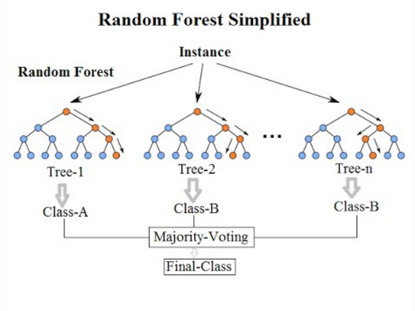
Random Forest
Random Forest jest szczególnych przypadkiem baggingu, w którym
1. Słabymi algorytmami są drzewa klasyfikacyjne / regresyjne
2. W każdym podziale drzewa (na kolejne liście) wybierana jest losowo część zmiennych (nie sprawdzamy wszystkich możliwych podziałów, tylko te losowo wybrane). Procedura ta usuwa korelacje pomiędzy drzewami.
Notes:
A transparent future is technically a sequential future with instant signaling of conditions (including errors and warnings) and where evaluation, and therefore also assignments, take place in the calling environment. Transparent futures are particularly useful for troubleshooting errors that are otherwise hard to narrow down.
A multisession future is evaluated in a background R session running on the same machine as the calling R process. (wiele procesów R)
Multicore: forking of processes. Forking an R process is considered faster than working with a separate R session running in the background. One reason is that the overhead of exporting large globals to the background session can be greater than when forking is used. The only real different between using multicore and multisession futures is that any output written (to standard output or standard error) by a multicore process is instantaneously outputted in calling process
Multiprocess: nie wiemy więc chcemy oba. Sometimes we do not know whether multicore futures are supported or not, but it might still be that we would like to write platform-independent scripts or instructions that work everywhere.
cl <- parallel::makeCluster(c("n1", "n2", "n3"))
plan(cluster, workers=cl)
Remote: remote R sessions

Slide 12
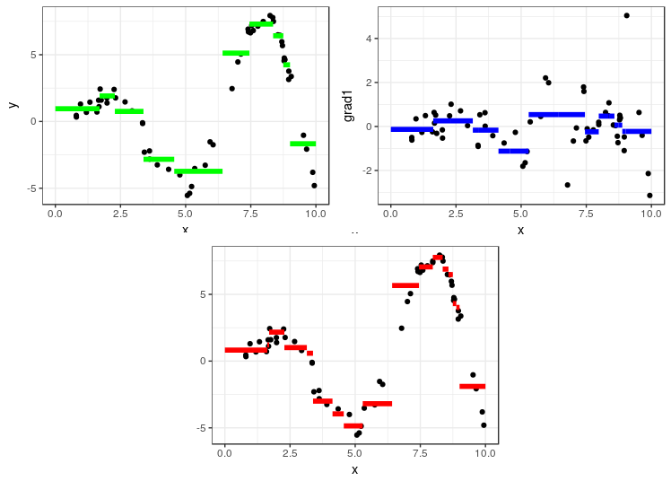
Boosting
Boosting to zbiór metod, w której kolejne modele liczone są sekwencyjnie.
Zastanówmy się nad poniższą procedurą:
1. Wybierzmy algorytm A i obliczmy predykcje f(x) dla naszego zbioru
2. Obliczmy reszty modelu y-f(x)
3. Zastosujmy algorytm A dla danych (x, y-f(x)) otrzymując predykcje g(x)
4. Do predykcji f(x) dodajmy g(x) otrzymując w ten sposób lepsze dopasowanie.
5. Jeśli dopasowanie nadal nie jest zadowalające możemy to powtórzyć...
Notes:
A transparent future is technically a sequential future with instant signaling of conditions (including errors and warnings) and where evaluation, and therefore also assignments, take place in the calling environment. Transparent futures are particularly useful for troubleshooting errors that are otherwise hard to narrow down.
A multisession future is evaluated in a background R session running on the same machine as the calling R process. (wiele procesów R)
Multicore: forking of processes. Forking an R process is considered faster than working with a separate R session running in the background. One reason is that the overhead of exporting large globals to the background session can be greater than when forking is used. The only real different between using multicore and multisession futures is that any output written (to standard output or standard error) by a multicore process is instantaneously outputted in calling process
Multiprocess: nie wiemy więc chcemy oba. Sometimes we do not know whether multicore futures are supported or not, but it might still be that we would like to write platform-independent scripts or instructions that work everywhere.
cl <- parallel::makeCluster(c("n1", "n2", "n3"))
plan(cluster, workers=cl)
Remote: remote R sessions

Slide 13
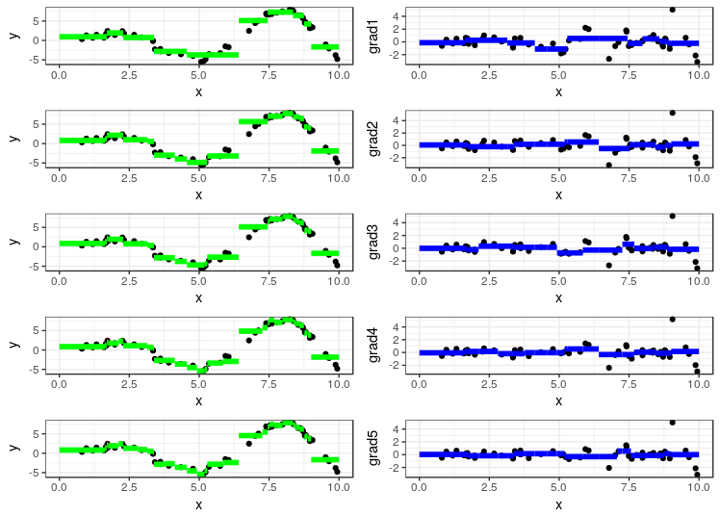
Gradient boosting
Opisany przykład to przypadek Gradient boostingu.
W ogólnym przypadku gradient boostingu zamiast reszt modelu obliczamy gradient funkcji straty po f(x). W przypadku gdy funkcją straty jest MSE gradienty są równe resztom. Występuje także stała learning rate, która mówi jak bardzo uwzględniamy kolejne gradienty:
F(x) = f(x) + r*g₁(x) + r*g₂(x) + ...
Notes:
A transparent future is technically a sequential future with instant signaling of conditions (including errors and warnings) and where evaluation, and therefore also assignments, take place in the calling environment. Transparent futures are particularly useful for troubleshooting errors that are otherwise hard to narrow down.
A multisession future is evaluated in a background R session running on the same machine as the calling R process. (wiele procesów R)
Multicore: forking of processes. Forking an R process is considered faster than working with a separate R session running in the background. One reason is that the overhead of exporting large globals to the background session can be greater than when forking is used. The only real different between using multicore and multisession futures is that any output written (to standard output or standard error) by a multicore process is instantaneously outputted in calling process
Multiprocess: nie wiemy więc chcemy oba. Sometimes we do not know whether multicore futures are supported or not, but it might still be that we would like to write platform-independent scripts or instructions that work everywhere.
cl <- parallel::makeCluster(c("n1", "n2", "n3"))
plan(cluster, workers=cl)
Remote: remote R sessions

Slide 14
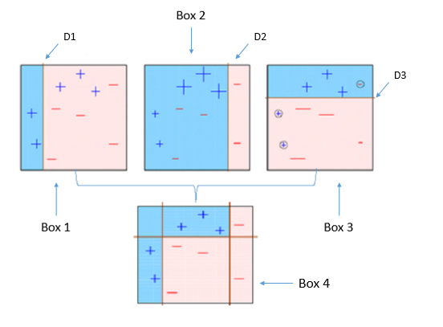
AdaBoost
AdaBoost działa na podobnej zasadzie, zamiast gradientów używa jednak wag.
1. Inicjalizujemy wagi dla każdej obserwacji: 1/n
2. Wybierzmy algorytm A i obliczmy predykcje f₀(x) dla naszego zbioru
2. Obliczmy reszty modelu y-f₀(x) oraz nowe wagi na ich podstawie. Jeśli błąd dla danej obserwacji był duży dostanie ona dużą wagę.
3. Zastosujmy algorytm A dla zważonych danych otrzymując predykcje f₁(x). Algorytm powinien skupić większą uwagę na błędnych obserwacjach.
4. Do predykcji f₀(x) dodajmy f₁(x) ze stałą learning rate.
5. Jeśli dopasowanie nadal nie jest zadowalające możemy to powtórzyć...
Notes:
A transparent future is technically a sequential future with instant signaling of conditions (including errors and warnings) and where evaluation, and therefore also assignments, take place in the calling environment. Transparent futures are particularly useful for troubleshooting errors that are otherwise hard to narrow down.
A multisession future is evaluated in a background R session running on the same machine as the calling R process. (wiele procesów R)
Multicore: forking of processes. Forking an R process is considered faster than working with a separate R session running in the background. One reason is that the overhead of exporting large globals to the background session can be greater than when forking is used. The only real different between using multicore and multisession futures is that any output written (to standard output or standard error) by a multicore process is instantaneously outputted in calling process
Multiprocess: nie wiemy więc chcemy oba. Sometimes we do not know whether multicore futures are supported or not, but it might still be that we would like to write platform-independent scripts or instructions that work everywhere.
cl <- parallel::makeCluster(c("n1", "n2", "n3"))
plan(cluster, workers=cl)
Remote: remote R sessions

Slide 15
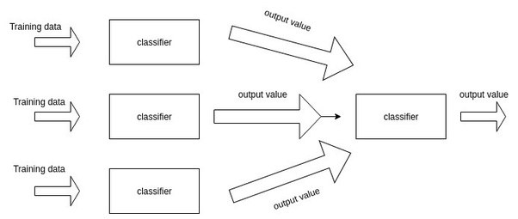
Stacking
Stacking jest metodą pozwalającą na połączenie rożnych algorytmów.
Przebiega on dwuetapowo. W pierwszym etapie stosujemy każdy algorytm na zbiorze treningowym. Następnie dla każdego algorytmu liczymy predykcje dla zbioru treningowego. Predykcje te (ze wszystkich modeli) posłużą jako predyktory w modelu w drugim etapie.
Notes:
A transparent future is technically a sequential future with instant signaling of conditions (including errors and warnings) and where evaluation, and therefore also assignments, take place in the calling environment. Transparent futures are particularly useful for troubleshooting errors that are otherwise hard to narrow down.
A multisession future is evaluated in a background R session running on the same machine as the calling R process. (wiele procesów R)
Multicore: forking of processes. Forking an R process is considered faster than working with a separate R session running in the background. One reason is that the overhead of exporting large globals to the background session can be greater than when forking is used. The only real different between using multicore and multisession futures is that any output written (to standard output or standard error) by a multicore process is instantaneously outputted in calling process
Multiprocess: nie wiemy więc chcemy oba. Sometimes we do not know whether multicore futures are supported or not, but it might still be that we would like to write platform-independent scripts or instructions that work everywhere.
cl <- parallel::makeCluster(c("n1", "n2", "n3"))
plan(cluster, workers=cl)
Remote: remote R sessions

